Slide 1
Healthy Weight Work Group August 24, 2017

Slide 2
Goal: Discuss 2018-2020 Strategic Plan and request member’s feedback on updated plan. Learn about the Food and Faith Project.
Welcome & Introductions
Approval of Minutes and Announcements
Delegate’s Report
Strategic Planning Updates
Guest Speaker Presentation
Wrap-Up and Next Steps

Slide 3
Approval of Minutes and Member Announcements (5 minutes)
Recap and Approval of Minutes
Member Announcements

Slide 4
Delegate Report (5 minutes)
Farmers Market Update
HCLHIC/WIC staff and partners attended 7/30 Farmers Market. Educated 30 people on LHIC and provided 9 WIC vouchers.
Encourage WIC/SNAP clients to visit Oakland Mills Market on August 27th.

Slide 5
2018-2020 Healthy Weight Work Group Action Planning
Goal 1: Reduce obesity in Howard County.
Objective 1.1:
By June 30, 2020, collaborate on an initiative to target the general public and priority populations for improved physical activity.
Education and Communication Strategy: Increase community awareness about the importance of physical activity by:
Utilizing communication campaigns and promoting community events related to physical activity through the LHIC website and social media and participating in events when appropriate as determined by the audience and setting of the event.
Promoting resources and utilizing existing peer and community education resources and programs to engage community members in physical activity.
Increase access to physical activity resources for priority populations.

Slide 6
2018-2020 Action Planning
Prioritized Tactics:
Increase HCHLHIC website and social media utilization
Utilize messages consistent with community partners and stakeholders to promote physical activity
Walking and Biking Safety
Scholarship and free/low cost resource promotion
Promote and participate in outreach and educational events that collaborate with schools, community organizations, faith-based communities, MCO’s and others serving priority populations identified and which include the synchronization of messaging and provision of adequate services (for follow-up, etc.)
Promote physical activity throughout Howard County through collaborative efforts to introduce strategically placed point of decision markers.

Slide 7
2018-2020 Action Planning
Objective 1.2 :
By June 30, 2020, collaborate on an initiative to target the general
public and priority populations for improved nutrition.
Education and Communication Strategy: Increase community awareness about the importance of nutrition by:
Utilizing communication campaigns and promoting community events related to nutrition through the LHIC website and social media and participating in events when appropriate as determined by the audience and setting of the event.
Promoting resources and utilizing existing peer and community education resources and programs to engage community members in nutrition strategies.
Increase access to nutritious food resources for priority populations.

Slide 8
2018-2020 Action Planning
Prioritized Tactics:
Increase HCHLHIC website and social media utilization
Utilize messages consistent with community partners and stakeholders to promote nutrition
Horizon Foundation-Sugary Sweetened Beverages
Health snack options
Promote and participate in outreach and educational events that collaborate with schools, community organizations, faith-based communities, MCO’s and others serving priority populations identified and which include the synchronization of messaging and provision of adequate services (for follow-up, etc.)
Support the community-wide effort to reduce sugary-sweetened beverages and unhealthy snacks by promoting healthy snacks through the production of a fact sheet and through collaboration around educational initiatives for local sport clubs and programs.
Organize small group of resources offering healthy cooking classes and demonstrations in the county to coordinate programming and services to ensure reach throughout Howard County.

Slide 9
2018-2020 Action Planning

Slide 10
Membership Levels
Level 1 Member:
learn more about the resources available in my community
share events and activities with the coalition,
attend and participate in full HCLHIC meetings.
Level 2 Member:
learn more about the resources available in my community
share events and activities with the coalition
attend and participate in full HCLHIC and designated workgroup meetings
Level 3 Member:
learn more about the resources available in my community
share my organization’s events and activities with the coalition
attend and participate in full HCLHIC and designated workgroup meetings
commit services and resources to contribute to the coalition and to further work group activities.

Slide 11
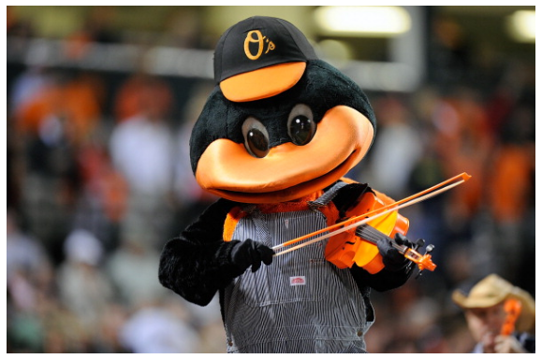
7th Inning Stretch- Healthy Meeting Stretch Break (2 Minutes)
Photo Credit: http://www.gettyimages.com/photos/7th-inning-stretch-boston?excludenudity=true&sort=mostpopular&mediatype=photography&phrase=7th%20inning%20stretch%20boston

Slide 12
Guest Speaker Presentation
Darriel Harris from Johns Hopkins Food and Faith Project

Slide 13
Next Steps and Wrap-up for Full Work Group (5 Minutes)
Next Meeting:
FULL LHIC Meeting: September 28th, 2017
8:30 – 10:30 a.m. Susquehanna
Next Workgroup meeting: October 26, 2017 9:00-10:30 a.m. Barton A

